Slide 1
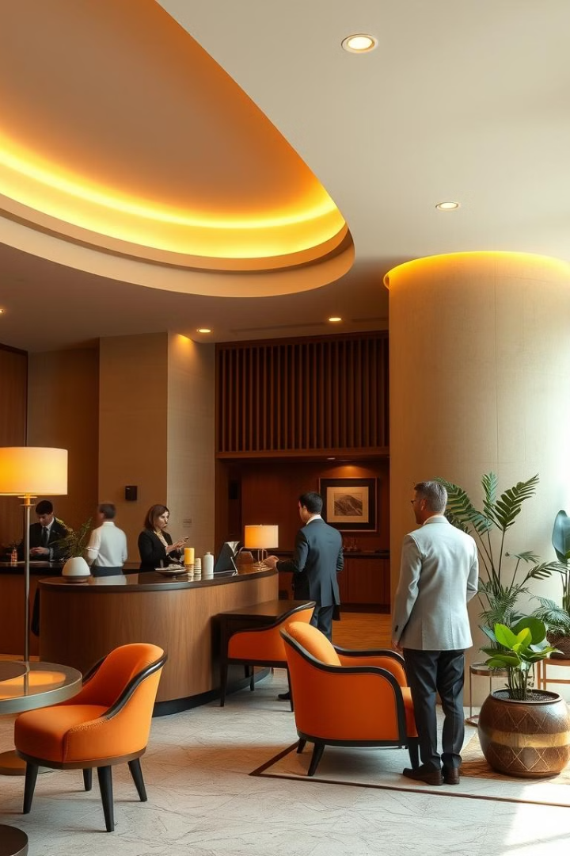
Hotel Management System
This presentation will guide you through the functionality of a Hotel Management System, showcasing its features and capabilities.
By Syeda Hareem Salman
F2024266529

Slide 2
Room Management
Adding Rooms
Viewing Rooms
The system allows you to add new rooms, specifying details like room number, type (single or double), and price per night. The system tracks the availability status of each room.
You can view a list of all available rooms, including their details and current status (available or booked). This provides a clear overview of the hotel's inventory.

Slide 3

Guest Management
1
Booking Rooms
2
Viewing Guests
Guests can book available rooms by providing their name and the desired number of days. The system calculates the total cost and updates the room's status to "Booked".
The system displays a list of all registered guests, including their details, room number, days of stay, total room price, food bill, and total bill.
3
Checking Out Guests
Guests can check out by providing their room number. The system updates the room's status back to "Available" and removes the guest from the system.

Slide 4




Food Ordering
Adding Menu Items
Viewing the Menu
The system allows you to add new menu items, specifying their name and price. This creates a comprehensive menu for guests to choose from.
Guests can view the available menu items with their corresponding prices. This provides a clear overview of the dining options.
Ordering Food
Guests can order food by providing their room number and selecting items from the menu. The system keeps track of the food bill for each guest.

Slide 5




System Architecture
User Interface
1
The system provides a user-friendly interface for interacting with its various features.
Data Structures
2
The system utilizes data structures like arrays to store information about rooms, guests, and menu items.
Functions
3
The system implements functions to perform various operations, such as adding rooms, booking rooms, and ordering food.
Database
4
The system can optionally integrate with a database to store and retrieve data persistently.

Slide 6
Key Features and Benefits
Core Functionality:
Features: Room management (add, view, book), guest tracking (view, checkout), menu and food order handling.
Benefits: Streamlines basic hotel operations, automates record-keeping, provides a centralized system for managing rooms,
guests, and dining.
.
1
Improved Efficiency
2
The system reduces manual effort and errors, leading to increased efficiency and productivity for hotel staff.
Enhanced Guest Experience
3
The system provides guests with a convenient and personalized experience, from booking rooms to ordering food.
Limitations:
Features: Fixed capacity (100 rooms/guests/menu items), no data persistence (data is lost when the program closes).
Benefits: Simple implementation for demonstration purposes, easy to understand. However, these limitations would need to be addressed for a real-world application.
4

Slide 7
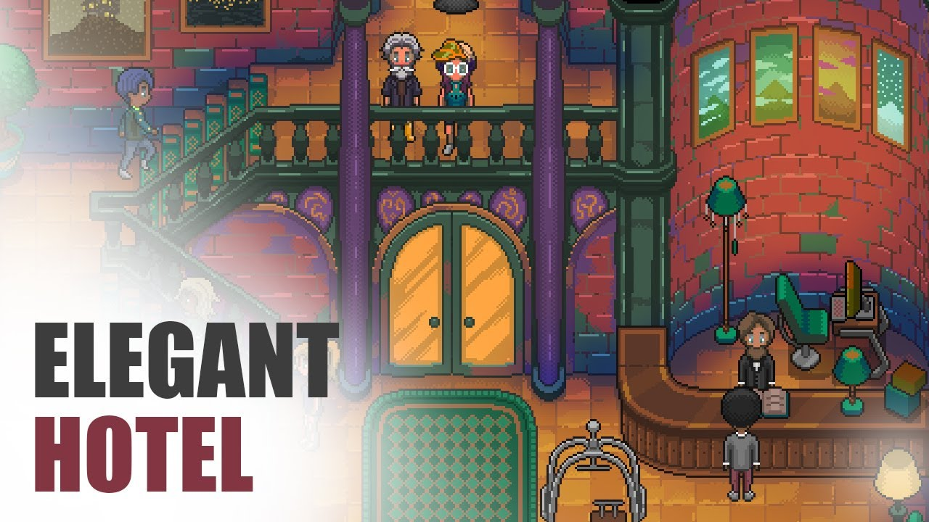
Conclusion
The Hotel Management System offers a comprehensive solution for managing hotel operations, enhancing guest satisfaction, and improving overall efficiency. By automating tasks, providing data-driven insights, and streamlining processes, the system empowers hotels to deliver exceptional service and optimize their operations.

